Slide 1
UNIT II DIVIDE AND CONQUER
Session – 11

Slide 2
Syllabus
Introduction, Binary Search - Merge sort and its algorithm analysis - Quick sort and its algorithm analysis - Strassen's Matrix multiplication - Finding Maximum and minimum - Algorithm for finding closest pair - Convex Hull Problem

Slide 3
Introduction
Divide / Break
Conquer / Solve
Merge / Combine

Slide 4
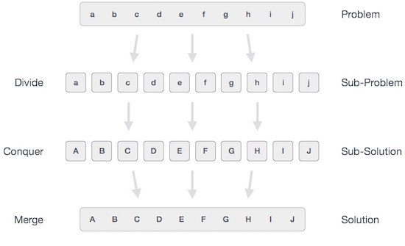

Slide 5
Quick Sort algorithm
Quick sort works by partitioning a given array A[p . . r] into two non-empty sub array A[p . . q] and A[q+1 . .r] such that every key in A[p . . q] is less than or equal to every key in A[q+1 . . r].
Then the two sub arrays are sorted by recursive calls to Quick sort. The exact position of the partition depends on the given array and index q is computed as a part of the partitioning procedure

Slide 6
Quicksort()
QuickSort ()
1. If p < r then
2. Partition (A, p, r)
3. Recursive call to Quick Sort (A, p, q)
4. Recursive call to Quick Sort (A, q + 1, r)
As a first step, Quick Sort chooses as pivot one of the items in the array to be sorted. Then array is then partitioned on either side of the pivot.
Elements that are less than or equal to pivot will move toward the left and elements that are greater than or equal to pivot will move toward the right.

Slide 7
Partitioning procedure
PARTITION (A, p, r)
1. x ← A[p]
2. i ← p+1
3. j ← r
4. while TRUE do
5. Repeat j ← j-1
6. until A[j] ≤ x
7. Repeat i ← i+1
8. until A[i] ≥ x
9. if i < j
10. then exchange A[i] ↔ A[j]
11. else return j

Slide 8

Example
Partitioning begins by locating two position markers—let’s call them leftmark and rightmark—at the beginning and end of the remaining items in the list (positions 1 and 8). The goal of the partition process is to move items that are on the wrong side with respect to the pivot value while also converging on the split point. This process as we locate the position of 54.

Slide 9
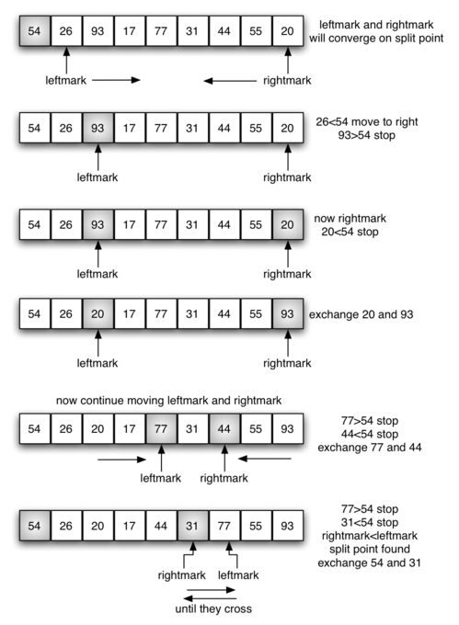

Slide 11
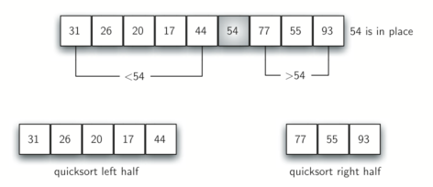

Slide 12
Analysis of Quick Sort
Best Case
The best thing that could happen in Quick sort would be that each partitioning stage divides the array exactly in half. In other words, the best to be a median of the keys in A[p . . r] every time procedure 'Partition‘ is called. The procedure 'Partition' always split the array to be sorted into two equal sized arrays.
If the procedure 'Partition' produces two regions of size n/2. the recurrence relation is then
T(n) = T(n/2) + T(n/2) + O(n)
= 2T(n/2) + O(n)
And from case 2 of Master theorem
T(n) = (n lg n)

Slide 13
Worst-case
When quicksort always has the most unbalanced partitions possible, then the original call takes cn, time for some constant c, the recursive call on n-1 elements takes c(n-1) time, the recursive call on n-2elements takes c(n−2) and so on.

Slide 14
When we total up the partitioning times for each level, we get
c(n) + c(n-1) + c(n-2) + c(n-3) +.. 2c = c(n+(n-1)+(n-2)+...(2))
= c(1+2+3+...+n) – c(1)
= c(n(n+1)/2) - c
= Θ (n²)

Slide 15
Using Master’s theorem
Best Case
T(n) = 2T(n/2) + ϴ(n)
T(n) = aT(n/b) + f(n) where a >= 1 and b > 1
a = 2 b = 2 f(n) = n
If f(n) < O(n^{log}_{b}ª), then T (n) = ϴ (n^{log}_{b}ª).
If f(n) = ϴ (n^{log}_{b}ªlog^{k}n) with k≥0, then T (n) = ϴ (n^{log}_{b}ªlog^{k+1}n).
If f(n) > Ω (n^{log}_{b}ª), and f(n) satisfies the regularity condition, then T (n) = ϴ (f(n)).
Calculate n^{log}_{b}ª = n^{log}₂² = n
Compare with f(n). Since f(n) = n^{log}_{b}ª
i.e. n = n
Case 2 is satisfied hence complexity is given as
T(n) = Θ(f(n)logn) = Θ (nlogn)

Slide 16
Worksheet No. 11

